Slide 1
How to learn new things in R
(by yourself)

Slide 2
Our learning process so far
I teach a variety of new tools and (try to) explain how they work and when to use them
You take those tools and practice with them, (hopefully) adding them to your repertoire

Slide 3
Extending things
But what happens when you know what you want to do, but you don’t know what function(s) in R will do what you want?
Or maybe you want to do something complicated and can’t quite put things together.

Slide 4

Extending things

Slide 5
The process of learning in R
Encounter new problem
Think about the logical steps you’d need to take to solve it - i.e. what needs to happen
Assuming you don’t know how to make those things happen, you search online sources and find the answer
That answer becomes part of your repertoire

Slide 6
Where to look?
http://stackoverflow.com/questions/tagged/r
http://www.statmethods.net/
https://www.r-bloggers.com/
Or google it!

Slide 7
Case study
I have some messy data where the string ‘age’ occurs before the numerical age in my age variable.
I need to know how to remove part of a string (‘age’) from a variable in R

Slide 8
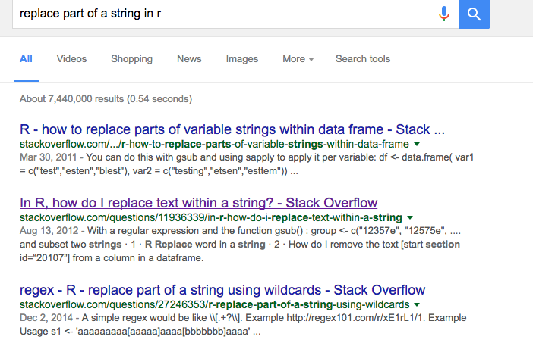
Case study

Slide 9
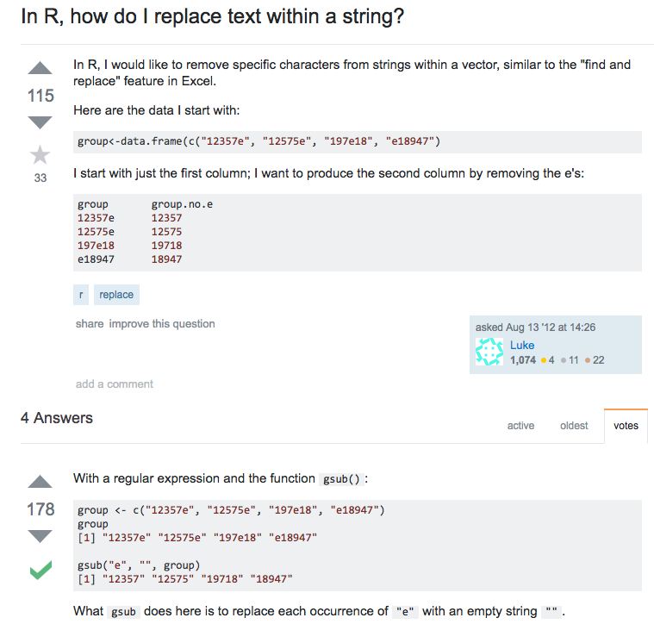
Case study

